Slide 1
Software Product Management Team & People aspects
Nandagopal Govindan

Slide 2
Contents
Product team roles
Principles of strong product teams
PM role: Variations across companies
What it takes to be a good PM
PM Profile: Jane Manning of Google AdWords

Slide 3
Product Team roles
(Book: Inspired)
Key roles:
Product Manager
Designer
Engineer
Product Marketing

Slide 4
Product manager
Overall in-charge of product
Drive product from concept to development to continuous evolution
Work closely with UX & Engineering
Possesses
Technology sophistication: knowledge, trends, applications
Deep customer knowledge - their issues, pains, desires, how they think, how they work, and how they decide to buy.
Market & Industry knowledge: competitors, technology trends, understanding the role of social media for your market and customers, trade magazines, conferences

Slide 5
Designer
Understands user personas, customer journeys
Design UX
Carry out usability testing
Design for accessibility

Slide 6
Engineer
Architect the solution
Develop Proof-of-concept
Use Agile, DevOps
Carry out A/B testing

Slide 7
Product marketing
Understand customer segments & size
Positioning, messaging, Go-to-market plan
Measure impact of market campaigns

Slide 8
Principles of strong product teams
(Book: Inspired)
Missionaries: Need teams committed to solving problems for their customers
They are empowered to figure out the best way to meet those objectives, and they are accountable for the results
Team size: Around 8–12 engineers - two‐pizza rule
True collaboration – no hierarchy
Preferably co-located
Scope well defined: For example, you might be working on a team at eBay that's responsible for detecting and preventing frauds
Team duration: It takes time to get to know one another, and learn how to work well together. So, teams should stick together longer
Team autonomy: they are able to try to solve the problems they are assigned in the best way they see fit.

Slide 9
Case study – Stages in Team development

Slide 10
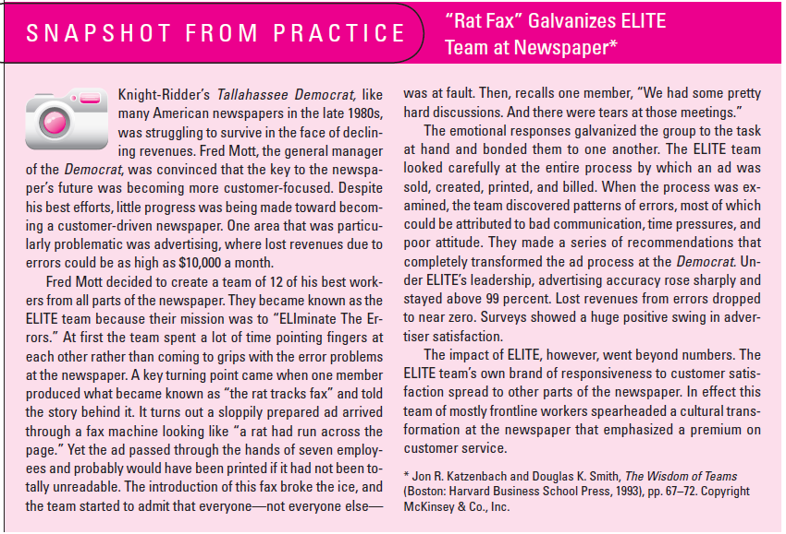
Source: Book: Project Management – A Managerial process, by Erik Larson

Slide 11
‘Rat Fax’ case study
What was the problem to be solved?
How did the meetings go in the beginning?
How did the team own up responsibility?
What was the impact of the improvement achieved on other teams?
What are you experiences in team formation and team maturing?

Slide 12
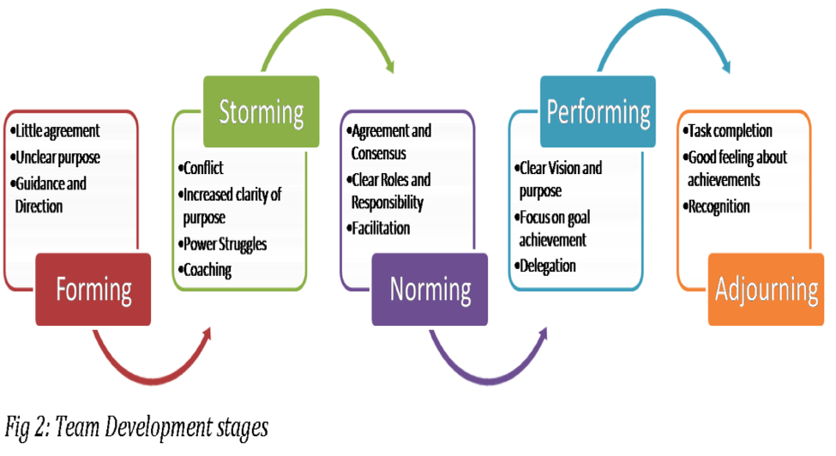
Different stages of a team
Created by: Psychologist Bruce Tuckman

Slide 13
Why teaming is important?
The difference in productivity between an average team and a turned-on, high-performing team is not 10 percent, 20 percent, or 30 percent, but 100 percent, 200 percent, even 500 percent! —Tom Peters, management consultant and writer
An organization succeeds when people trust each other and cooperate with each other

Slide 14
Case study in building a good team

Slide 15
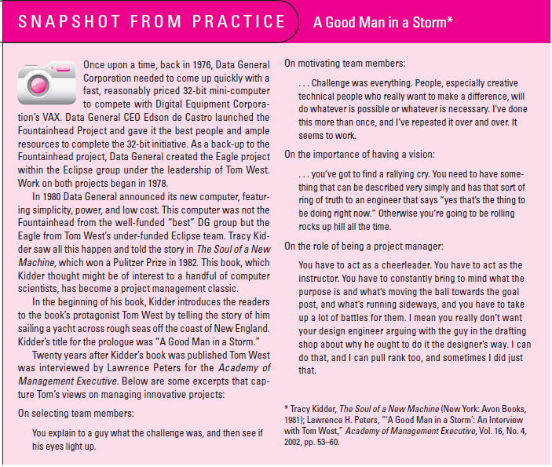
Source: Book: Project Management – A Managerial process, by Erik Larson

Slide 16
Data General case study
What lessons in team building can we learn from Tom West?

Slide 17
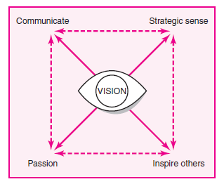
Creating a good vision
Something that aligns with the strategy of the org.
Discuss with all
Vision should have a higher purpose
Something that excites the team
Ex. The CEO of a pharma company said – let us develop a drug that will eradicate Malaria from Africa. This inspired the whole org
Source: Book: Project Management – A Managerial process, by Erik Larson

Slide 18
Exercise: Defining a vision
Design a vision / goal for your product / project that will truly inspire the entire team

Slide 19
Characteristics of good teams
(Book: Inspired)
Good teams have a compelling product vision that they pursue with a missionary‐like passion. Bad teams are mercenaries.
Good teams get their inspiration from observing customers' struggle
Good teams are skilled in the many techniques to rapidly try out product ideas
Good teams love to have brainstorming discussions with smart thought leaders from across the company.
Good teams have product, design, and engineering sit side by side, and they embrace the give and take between the functionality, the user experience, and the enabling technology.
Good teams engage directly with customers, to better understand their customers, and to see the customer's response to their latest ideas.
Good teams know that many of their favourite ideas won't end up working for customers.
Good teams understand the need for speed and how rapid iteration is the key to innovation

Slide 20
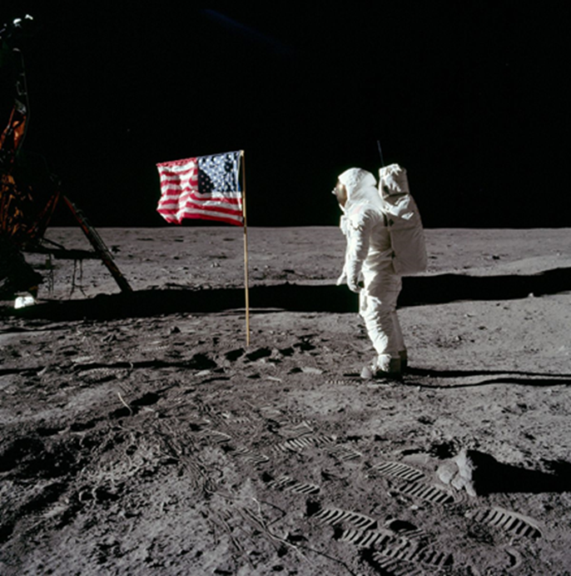
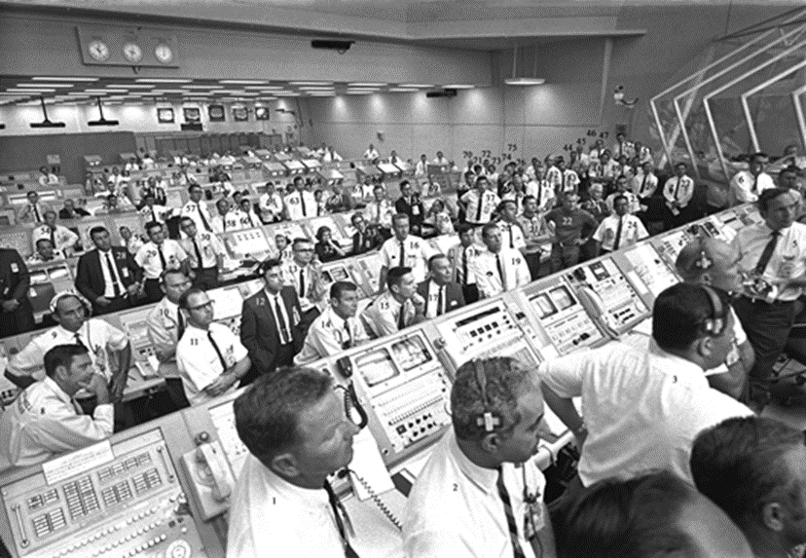
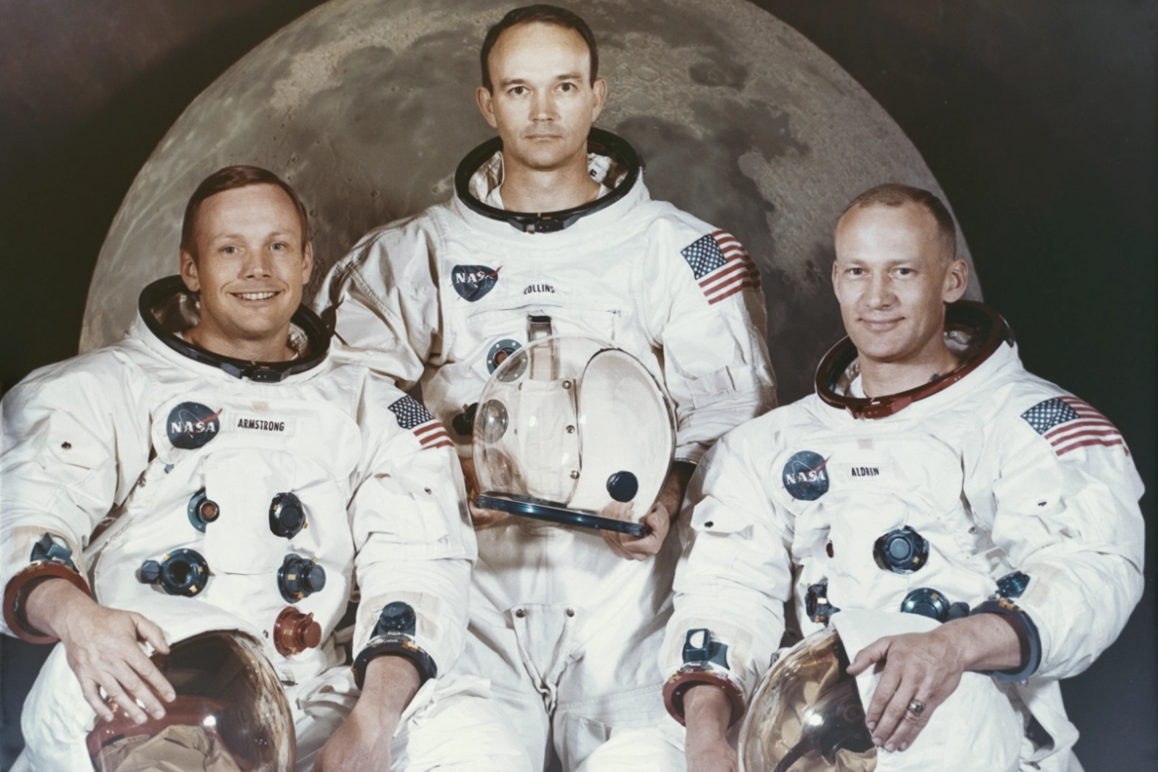
Power of a common goal
Apollo 11
In 1969, Neil Armstrong and Buzz Aldrin became the first men to walk on the moon, a momentous achievement in human history, which is yet to be surpassed.
While these two men have gone down in history, they wouldn’t have made it off the ground without the support of a massive team.
Over 300,000 men and women collaborated on the Apollo launch, from surveyors to the engineers, to the astronauts themselves.
Every person that worked on the moon landing understood the goal they were working towards.
This is best exemplified by President Kennedy’s conversation with a janitor when he visited Nasa in 1962.
When the president asked him what he did, the man proudly replied. “I’m helping to put a man on the moon.”
How do you think this must have happened – even the janitor is inspired?
Ref: vouchforme.co

Slide 21

Example of great team work in nature
Look at how the Geese fly:
Human teams could learn a lot about teamwork by observing Geese.
Every winter, flocks of Geese take to the skies and work together to achieve their common goal of reaching a warmer climate.
Common errors with human teams include lack of communication and allowing some members to take all the pressure while others coast through, but flocks of Geese never have these problems.
As they fly, they honk loudly, motivating their tired teammates, and by flying in a V-shape formation, the leaders reduce air drag for those behind them.
When the lead Goose is struggling, another one from the back swaps to give their companion a break.
The result means that all members of the flock work and recover equally.
What can we learn from the geese?
Ref: vouchforme.co

Slide 22
Some aspects of team: Few Questions
Do you participate in customer meetings, do you visit the customer?
How can you deeply understand the customer needs in your product ?
Do you consider different ideas from team members to solve a complex issue?
How can you bring in a culture of collective problem solving in your team?

Slide 23
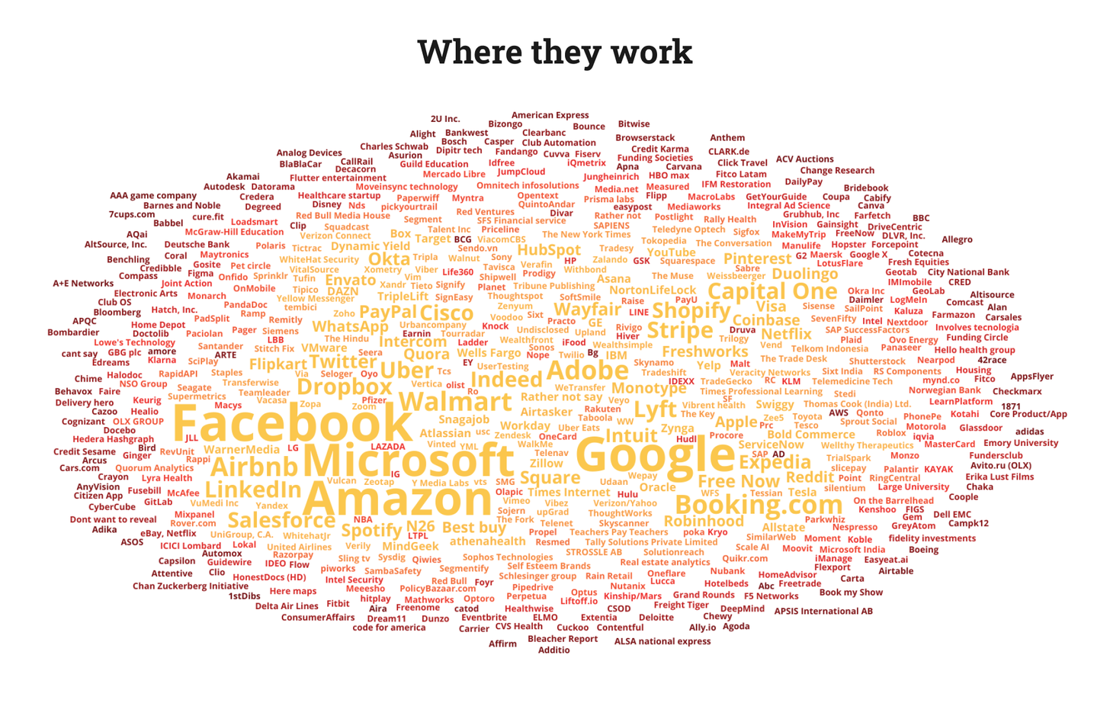
How PM roles different in different companies? A survey(lennysnewsletter.com)
Survey participants
Year:

Slide 24
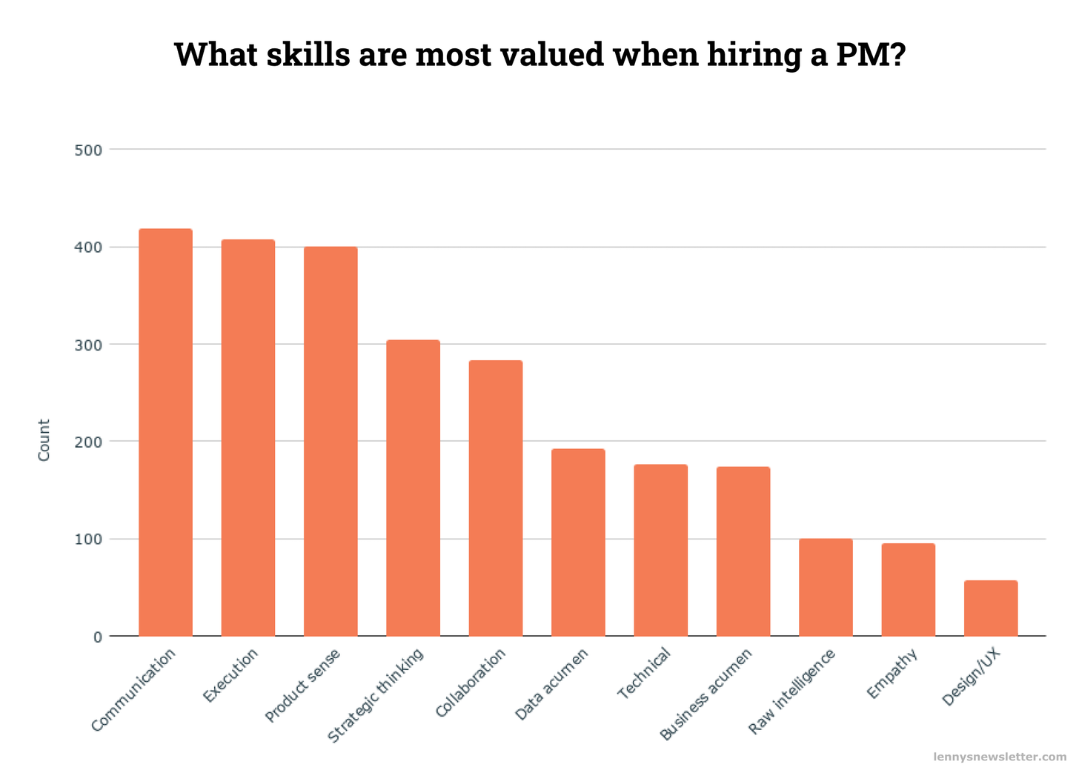
Survey results…
Most frequently valued: Communication, execution, product sense
Least frequently valued: Design/UX, empathy, raw intelligence

Slide 25
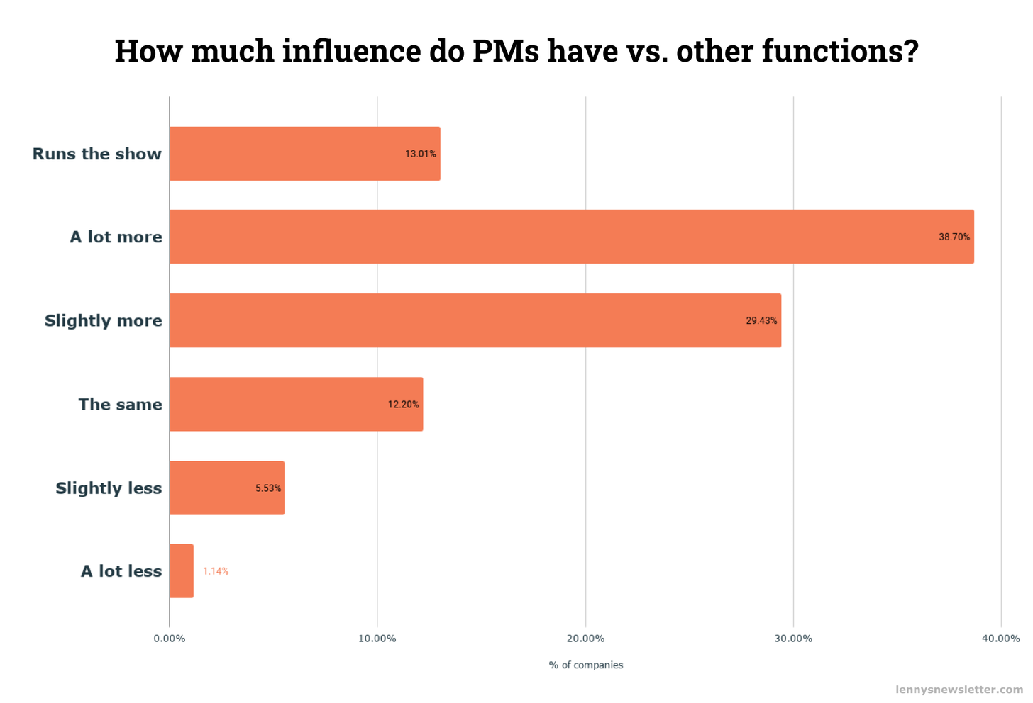
Survey results…
Noteworthy companies where PMs have a lot more influence: YouTube, LinkedIn, Twitter, Uber, Robinhood, Lyft, Coinbase, Asana, Airbnb
Noteworthy companies where PMs have relatively less influence: Apple, Oracle, Stripe, Tesla

Slide 26
Survey results…
Heart vs. Hands vs. Head
It's often said that companies are defined by how they index on Heart (e.g. empathy, culture) vs. Hands (e.g. execution) vs. Head (e.g. intelligence).
Takeaways:
Companies who spike on Heart: Asana, Spotify, WhatsApp
Companies who spike on Hands: Flipkart, Okta, PayPal, Quora, Tesla, Wayfair, Yelp
Companies who spike on Head: Coinbase, Uber, YouTube, Zynga
To which category does your company largely belong?

Slide 27
What it takes to be a good PM?
(hbr.org)
Aspiring PMs should consider three primary factors when evaluating a role:
Core competencies
Emotional intelligence (EQ)
Company fit

Slide 28
Core competencies
(hbr.org)
Conducting customer interviews and user testing
Running design sprints
Feature prioritization and road map planning
The art of resource allocation (it is not a science!)
Performing market assessments
Translating business-to-technical requirements, and vice versa
Pricing and revenue modeling
Defining and tracking success metrics
Rate yourself on a scale of 1 to 5 on each of these and identify areas for improvement. Do not share in chat box.
Identify one key action to improve in one key area where you are weak. Do not share in the chat box.
After the class, create an action plan and monitor progress every month. Promise?

Slide 29
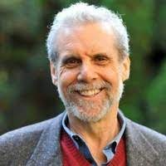
Emotional Intelligence
Emotional intelligence or EI is the ability to understand and manage your own emotions, and those of the people around you
The theory behind this was proposed by Daniel Goleman
EQ is considered to be greater than IQ. This is the reason many intelligent people do not make great leaders if they lack in EQ
Daniel Goleman

Slide 30
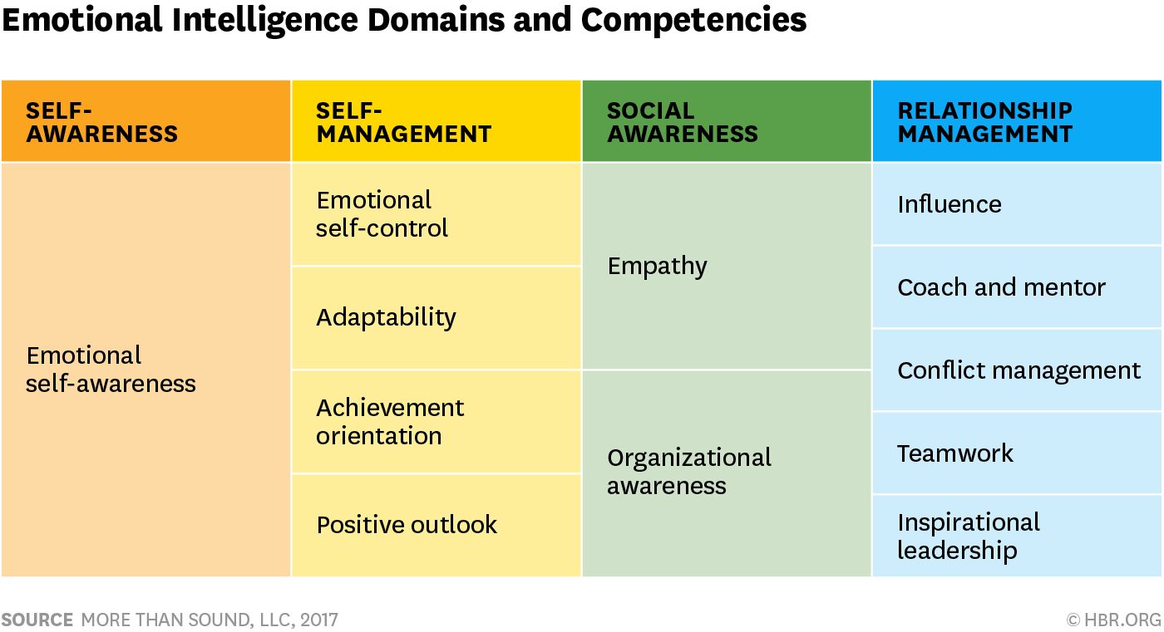
Emotional intelligence
Emotions, strengths, weaknesses, drives, values and goals

Slide 31
Scene in an emotionally intelligent office
An upset employee finds a compassionate ear. ...
People listen to each other in meetings. ...
People express themselves openly. ...
Most change initiatives work. ...
Flexibility. ...
People have the freedom to be creative. ...
https://magazinestoday.co.nz/7-great-examples-emotional-intelligence-workplace/People meet out of work time.

Slide 32
Example of High EQ person – JRD Tata
Made friends easily
Ran the Tata group consisting of several top notch CEOs like Russi Modi (Tata Steel), Moolgaokar (Tata Motors)…
Gave them freedom, compromised his own opinions in order to respect them
Bold & Adventurous – Tata Airlines then became Air India

Slide 33
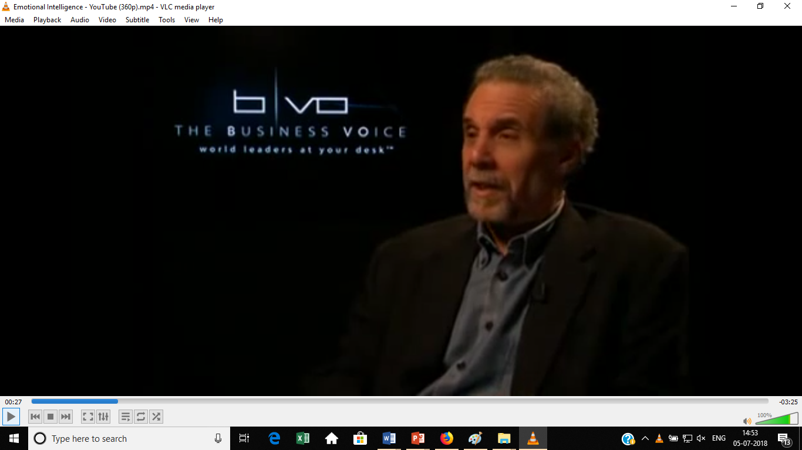
Importance of EQ
Video: https://www.youtube.com/watch?v=wJhfKYzKc0s

Slide 34
Leadership styles
Democratic
Authoritative
Coercive
Coaching

Slide 35
Leadership styles…
Democratic: Trusts people to do the right things, Listens to concerns. Works best when employees are knowledgeable and only need coordination
Authoritative: Articulates vision and approach, Sets standards & monitors performance. Best when team is new and not very skilled and PM is an expert
Coercive: Gives lot of directives, Expects immediate compliance, Close monitoring & control. Best during a crisis, when minor deviations might result in serious problems, dealing with problem employees, applied to straight forward tasks
Coaching: Helps employees identify unique strengths and weaknesses, encourages team members to establish long term development goals. Best when the engagement is a long one 2-4 years

Slide 36
Company fit
(hbr.org)
Technical skills needed: Some products are very technical – AI, Analytics
Company philosophy about PM (relationship with engineering) – PM drives engineering, Engineering drives Product, Partnership
Stage of company: Startup (broad exposure & expectations), mature (more focused role)
Relationship with Leadership: Level of Autonomy to PMs

Slide 37

Profile: Jane Manning of Google AdWords
Questions:
What challenges of a PM are highlighted in this article?
What qualities of Jane do you appreciate and why?

Slide 38
Appendix

